Slide 1
USE CASE MODEL
Intuitively, the use cases represent the different ways in which a system can be used by the users.
A simple way to find all the use cases of a system is to ask the question —“What all can the different categories of users do by using the system?”
Thus, for the library information system (LIS), the use cases could be:
issue-book
query-book
return-book
create-member
add-book, etc.
The purpose of a use case is to define a piece of coherent behavior without revealing the internal structure of the system.
The use cases do not mention any specific algorithm to be used nor the internal data representation, internal structure of the software.

Slide 2
Use Case Model
A use case typically involves a sequence of interactions between the user and the system. Even for the same use case, there can be several different sequences of interactions.
A use case consists of one main line sequence and several alternate sequences.
For example, in the mainline sequence of the withdraw cash use case supported by a bank ATM would be—the user inserts the ATM card, enters password, selects the amount withdraw option, enters the amount to be withdrawn, completes the transaction, and collects the amount. Several variations to the main line sequence (called alternate sequences) may also exist.
Typically, a variation from the mainline sequence occurs when some specific conditions hold.
For the bank ATM example, consider the following variations or alternate sequences:
Password is invalid.
The amount to be withdrawn exceeds the account balance.

Slide 3
Use Case Model
A use case can be viewed as a set of related scenarios tied together by a common goal. The main line sequence and each of the variations are called scenarios or instances of the use case. Each scenario is a single path of user events and system activity.
The use case model is an important analysis and design artifact.
Other UML models must conform to this model in any use case driven (also called as the user-centric) analysis and development approach.
It should be remembered that the “use case model” is not really an object-oriented model according to a strict definition of the term.
In contrast to all other types of UML diagrams, the use case model represents afunctional or process model of a system.

Slide 4
Representation of Use Cases
A use case model can be documented by drawing a use case diagram and writing an accompanying text elaborating the drawing.
In the use case diagram, each use case is represented by an ellipse with the name of the use case written inside the ellipse.
All the ellipses (i.e. use cases) of a system are enclosed within a rectangle which represents the system boundary.
The stereotype construct when used to annotate a basic symbol, can give slightly different meaning to the basic symbol— thereby eliminating the need to have several symbols whose meanings differ slightly from each other.
The following are some of the information which may be included in a use case text description in addition to the mainline sequence, and the alternate scenarios.

Slide 5
Representation of Use Cases
Contact persons: This section lists of personnel of the client organisation with whom the use case was discussed, date and time of the meeting, etc.
Actors: In addition to identifying the actors, some information about actors using a use case which may help the implementation of the use case may be recorded.
Pre-condition: The preconditions would describe the state of the system before the use case execution starts.
Post-condition: This captures the state of the system after the use case has successfully completed.
Non-functional requirements : This could contain the important constraints for the design and implementation, such as platform and environment conditions, qualitative statements, response time requirements, etc.

Slide 6
Representation of Use Cases
Exceptions, error situations: This contains only the domain-related errors such as lack of user’s access rights, invalid entry in the input fields, etc. Obviously, errors that are not domain related, such as software errors, need not be discussed here.
Sample dialogs: These serve as examples illustrating the use case.
Specific user interface requirements : These contain specific requirements for the user interface of the use case. For example, it may contain forms to be used, screen shots, interaction style, etc.
Document references: This part contains references to specific domain related documents which may be useful to understand the system operation.

Slide 7
The use case diagram of the Supermarket prize scheme described in Figure

Slide 8
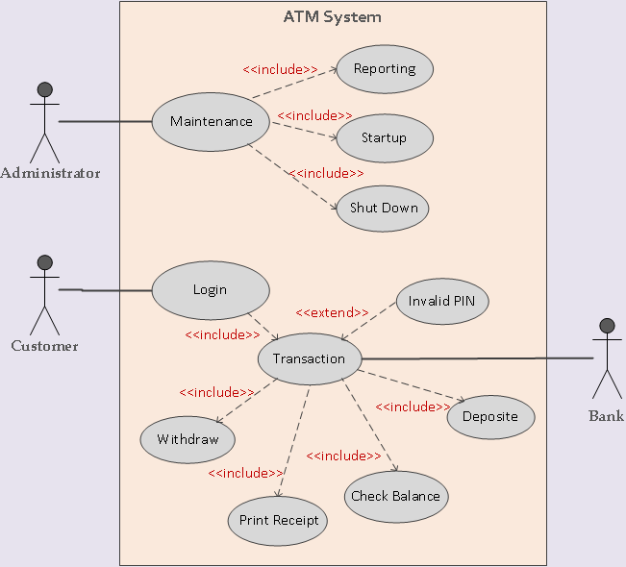
The use case diagram of the Supermarket prize scheme described in Figure

Slide 9
Why Develop the Use Case Diagram?
If you examine a use case diagram, the utility of the use cases represented by the ellipses would become obvious.
They along with the accompanying text description serve as a type of requirements specification of the system and the model based on which all other models are developed.
In other words, the use case model forms the core model to which all other models must conform.

Slide 10
How to Identify the Use Cases of a System?
Identification of the use cases involves brain storming and reviewing the SRS document.
Typically, the high-level requirements specified in the SRS document correspond to the use cases.
A popular method of identifying the use cases is actor-based.
This involves first identifying the different types of actors and their usage of the system.
Subsequently, for each actor the different functions that they might initiate or participate are identified.
For example, for a Library Automation System, the categories of users can be members, librarian, and the accountant.

Slide 11
Factoring of Commonality among Use Cases
Complex use cases need to be factored into simpler use cases. This would not only make the behavior associated with the use case much more comprehensible, but also make the corresponding interaction diagrams more tractable. Without decomposition, the interaction diagrams for complex use cases may become too large to be accommodated on a single standard-sized (A4) paper.
Use cases need to be factored whenever there is common behavior across different use cases. Factoring would make it possible to define such behavior only once and reuse it wherever required.

Slide 12
Generalization
Use case generalization can be used when you have one use case that is like another but does something slightly differently or something more.
Generalization works the same way with use cases as it does with classes.
The child use case inherits the behavior and meaning of the present use case.

Slide 13
Includes
The includes relationship in the older versions of UML (prior to UML 1.1) was known as the use's relationship.
The includes relationship implies one use case includes the behavior of another use case in its sequence of events and actions.
The includes relationship is appropriate when you have a chunk of behavior that is similar across several use cases.
The factoring of such behavior will help in not repeating the specification and implementation across different use cases.

Slide 14
Extends
The main idea behind the extends relationship among use cases is that it allows you show optional system behavior.
An optional system behavior is executed only if certain conditions hold, otherwise the optional behavior is not executed.

Slide 15
USE CASE PACKAGING
Packaging is the mechanism provided by UML to handle complexity.
When we have too many use cases in the top-level diagram, we can package the related use cases so that at best 6 or 7 packages are present at the top-level diagram.
Any modeling element that becomes large and complex can be broken up into packages.
The symbol for a package is a folder.
Just as you organize a large collection of documents in a folder, you organize UML elements into packages.
An example of packaging use cases is shown in Figure.

Slide 16
CLASS DIAGRAMS
A class diagram describes the static structure of a system.
It shows how a system is structured rather than how it behaves.
The static structure of a system comprises several class diagrams and their dependencies.
The main constituents of a class diagram are classes and their relationships—generalization, aggregation, association, and various kinds of dependencies.

Slide 17
Association

Slide 18
Aggregation

Slide 19
Composition

Slide 20
Inheritance

Slide 21
Dependency

Slide 22
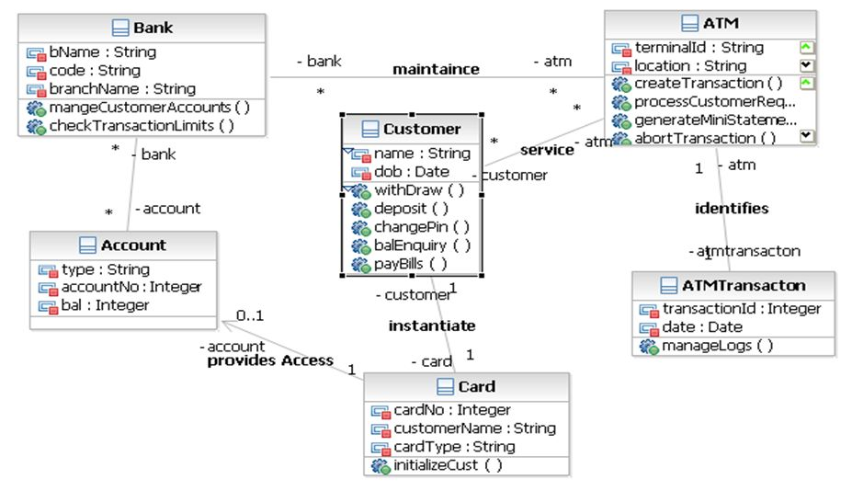

Slide 23
Object Diagrams
Object diagrams shows the snapshot of the objects in a system at a point in time.
Since it shows instances of classes, rather than the classes themselves, it is often called as an instance diagram.
The objects are drawn using rounded rectangles in Figure.

Slide 24
INTERACTION DIAGRAMS
When a user invokes one of the functions supported by a system, the required behavior is realised through the interaction of several objects in the system.
Interaction diagrams, as their name itself implies, are models that describe how groups of objects interact among themselves through message passing to realise some behavior.
Sometimes, especially for complex use cases, more than one interaction diagrams may be necessary to capture the behavior.
An interaction diagram shows a number of example objects and the messages that are passed between the objects within the use case.
There are two kinds of interaction diagrams—sequence diagrams and collaboration diagrams.
These two diagrams are equivalent in the sense that any one diagram can be derived automatically from the other.

Slide 25
Sequence diagram
A sequence diagram shows interaction among objects as a two-dimensional chart.
The chart is read from top to bottom.
The objects participating in the interaction are shown at the top of the chart as boxes attached to a vertical dashed line.
Inside the box the name of the object is written with a colon separating it from the name of the class and both the name of the object and the class are underlined.
This signifies that we are referring any arbitrary instance of the class.
For example, in Figure :Book represents any arbitrary instance of the Book class.

Slide 26
Collaboration diagram
A collaboration diagram shows both structural and behavioral aspects explicitly.
This is unlike a sequence diagram which shows only the behavioral aspects.
The structural aspect of a collaboration diagram consists of objects and links among them indicating association.
In this diagram, each object is also called a collaborator.
The behavioral aspect is described by the set of messages exchanged among the different collaborators.

Slide 27
ACTIVITY DIAGRAM
The activity diagram focuses on representing various activities or chunks of processing and their sequence of activation.
The activities in general may not correspond to the methods of classes.
An activity is a state with an internal action and one or more outgoing transitions which automatically follow the termination of the internal activity.
If an activity has more than one outgoing transitions, then exact situation under which each is executed must be identified through appropriate conditions.

Slide 28
STATE CHART DIAGRAM
A state chart diagram is normally used to model how the state of an object changes in its lifetime.
State chart diagrams are good at describing how the behavior of an object changes across several use case executions.
However, if we are interested in modelling some behavior that involves several objects collaborating with each other, state chart diagram is not appropriate.
We have already seen that such behavior is better modelled using sequence or collaboration diagrams.
State chart diagrams are based on the finite state machine (FSM) formalism.
An FSM consists of a finite number of states corresponding to those of the object being modelled.

Slide 29
Why state chart?
Major disadvantage of the FSM formalism is the state explosion problem.
The number of states becomes too many and the model too complex when used to model practical systems.
This problem is overcome in UML by using state charts.
The state chart formalism was proposed by David Harel [1990].
A state chart is a hierarchical model of a system and introduces the concept of a composite state (also called nested state ).
Actions are associated with transitions and are processes that occur quickly and are not interruptible.
Activities are associated with states and can take longer. An activity can be interrupted by an event.

Slide 30
Basic elements of a state chart
The basic elements of the state chart diagram are as follows:
Initial state: This represented as a filled circle.
Final state: This is represented by a filled circle inside a larger circle.
State: These are represented by rectangles with rounded corners.
Transition: A transition is shown as an arrow between two states. Normally, the name of the event which causes the transition is places along side the arrow. You can also assign a guard to the transition. A guard is a Boolean logic condition. The transition can take place only if the guard evaluates to true. The syntax for the label of the transition is shown in 3 parts [guard]event/action.
An example state chart for the order object of the Trade House Automation software is shown in Figure

Slide 31
Package diagram
A package is a grouping of several classes.
In fact, a package diagram can be used to group any UML artifacts.
Packages are popular way of organizing source code files.
Java packages are a good example which can be modelled using a package diagram.
Such package diagrams show the different class groups (packages) and their inter dependencies.
These are very useful to document organisation of source files for large projects that have many program files.
An example of a package diagram has been shown in Figure.

Slide 32
Component diagram
A component represents a piece of software that can be independently purchased, upgraded, and integrated into an existing software.
A component diagram can be used to represent the physical structure of an implementation in terms of the various components of the system.
A component diagram is typically used to achieve the following purposes:
Organize source code to be able to construct executable releases.
Specify dependencies among different components.
A package diagram can be used to provide a high-level view of each component in terms the different classes it contains.

Slide 33
Deployment diagram
The deployment diagram shows the environmental view of a system.
That is, it captures the environment in which the software solution is implemented.
In other words, a deployment diagram shows how a software system will be physically deployed in the hardware environment.
That is, which component will execute on which hardware component and how they will they communicate with each other.
The environmental view provided by the deployment diagram is important for complex and large software solutions that run on hardware systems comprising multiple components.

Slide 34
UML 2.0
UML 1.X lacked a few specialised capabilities that made it difficult to use in some non- traditional domains.
Some of the features that prominently lacked in UML 1.X include lack of support for representation of the following—concurrent execution of methods, development domain, asynchronous messages, events, ports, and active objects.
In many applications, including the embedded and telecommunication software development, capability to model timing requirements using a timing diagram was urgently required to make UML applicable in these important segments of software development.
Further, certain changes were required to support interoperability among UML-based CASE tools using XML metadata interchange (XMI).

Slide 35
UML 2.0 defines thirteen types of diagrams, divided into three categories as follows:
Structure diagrams: These include the class diagram, object diagram, component diagram, composite structure diagram, package diagram, and deployment diagram.
Behavior diagrams: These diagrams include the use case diagram, activity diagram, and state machine diagram.
Interaction diagrams: These diagrams include the sequence diagram, communication diagram, timing diagram, and interaction overview diagram. The collaboration diagram of UML 1.X has been renamed in UML 2.0 as communication diagram. This renaming was necessary as the earlier name was somewhat misleading, it shows the communications among the classes during the execution of a use case rather than showing collaborative problem solving.

Slide 36
Composite structure diagram
The composite structure diagram lets you define how a class is defined by a further structure of classes and the communication paths between these parts. Some new core constructs such as parts, ports and connectors are introduced.
Part: The concept of parts makes possible the description of the internal structure of a class.
Port: The concept of a port makes it possible to describe connection points formally. These are addressable, which means that signals can be sent to them.
Connector: Connectors can be used to specify the communication links between two or more parts.

Slide 37
THANK YOU

